Slide 1
SIVA PRIYA S
Final Project
3/21/2024 Annual Review

Slide 2
PROJECT TITLE
SENTIMENT ANALYSIS :
Sentiment analysis, also known as opinion mining, is a natural language processing (NLP) technique used to determine the sentiment expressed in textual data. It involves analyzing and categorizing the subjective information conveyed in text as positive, negative, or neutral.
In sentiment analysis, algorithms are trained to understand the sentiment or attitude conveyed by a piece of text, such as a sentence, paragraph, or document. This analysis can be applied to various types of text data, including social media posts, product reviews, customer feedback, news articles, and survey responses.
The primary goal of sentiment analysis is to extract insights from text data to understand public opinion, customer sentiment, market trends, and brand reputation. It is widely used in various applications, including market research, customer feedback analysis, social media monitoring, brand monitoring, and reputation management.
Sentiment analysis can be performed using different techniques, ranging from simple rule-based approaches to more complex machine learning and deep learning algorithms. Common methods include lexicon-based approaches, where sentiment scores are assigned to words based on pre-defined dictionaries, and supervised learning approaches, where machine learning models are trained on labeled data to classify sentiment automatically.
3/21/2024 Annual Review

Slide 3


AGENDA
PROBLEM STATEMENT
PROJECT OVERVIEW
TOOLS & LIBRARIES USED
MY SOLUTION AND ITS VALUE PROPORTION
WOW IN MY SOLUTION
MODELLING
RESULT
3/21/2024 Annual Review

Slide 4

PROBLEM STATEMENT
"Develop a sentiment analysis system capable of accurately classifying the sentiment expressed in textual data. The system should be able to analyze various forms of text, including social media posts, product reviews, news articles, and customer feedback.
The goal is to classify each piece of text as positive, negative, or neutral sentiment, providing insights into public opinion, customer satisfaction, and market trends.
The system should achieve high accuracy, handle large volumes of data efficiently, and be scalable for real-time analysis. Additionally, it should be capable of handling noisy text data, slang, abbreviations, and grammatical errors commonly found in informal communication channels.
The sentiment analysis system will be utilized to inform decision-making processes in marketing, customer service, reputation management, and other relevant areas."
3/21/2024 Annual Review

Slide 5

PROJECT OVERVIEW
The objective of this project is to develop a robust sentiment analysis system capable of accurately analyzing and classifying the sentiment of textual data. The system will focus on analyzing customer feedback to provide valuable insights for business decision-making.
The successful implementation of the sentiment analysis system will empower businesses to gain valuable insights from customer feedback, identify emerging trends and issues, and make data-driven decisions to enhance customer satisfaction and drive business growth.
The system will serve as a valuable tool for marketing teams, customer support departments, and product development teams to better understand customer sentiment and respond effectively to customer needs and concerns.
3/21/2024 Annual Review

Slide 6

Tools and libraries used ?
NLTK (Natural Language Toolkit): NLTK is a leading platform for building Python programs to work with human language data. It provides easy-to-use interfaces for tasks such as tokenization, stemming, lemmatization, and part-of-speech tagging, which are essential for preprocessing text data in sentiment analysis.
Scikit-learn: Scikit-learn is a powerful machine learning library for Python that offers simple and efficient tools for data mining and data analysis. It provides implementations of various machine learning algorithms, including classifiers like Support Vector Machines (SVM), Naive Bayes, and Decision Trees, which are commonly used for sentiment analysis tasks.
TensorFlow and Keras: TensorFlow is an open-source machine learning framework developed by Google for building and training deep learning models. Keras is a high-level neural networks API that runs on top of TensorFlow, providing an easy-to-use interface for building deep learning models, including recurrent neural networks (RNNs) and convolutional neural networks (CNNs), which are commonly used for sentiment analysis tasks.
3/21/2024 Annual Review

Slide 7

MY SOLUTION AND ITS VALUE PROPOSITION
Improved Decision Making: By accurately analyzing sentiment in textual data, businesses can make informed decisions regarding product development, marketing strategies, customer service, and reputation management.
Enhanced Customer Experience: Understanding customer sentiment allows businesses to identify areas for improvement and address customer concerns promptly, leading to higher satisfaction and loyalty.
Efficient Resource Allocation: Sentiment analysis helps businesses allocate resources effectively by prioritizing tasks based on customer feedback and market trends.
Competitive Advantage: Leveraging sentiment analysis provides businesses with a competitive edge by staying ahead of market trends, anticipating customer needs, and responding proactively to emerging issues.
Automated Insights: Sentiment analysis automates the process of analyzing large volumes of textual data, saving time and resources compared to manual analysis methods.
Real-time Monitoring: Sentiment analysis systems enable real-time monitoring of customer sentiment, allowing businesses to react swiftly to changing market conditions and public opinion.
3/21/2024 Annual Review

Slide 8

WOW IN MY SOLUTION
Accuracy: Assess the accuracy of the sentiment analysis model in correctly classifying the sentiment of the text data. A higher accuracy indicates that the model is better at distinguishing between positive, negative, and neutral sentiments.
Precision and Recall: Examine the precision and recall scores to understand the model's performance in correctly identifying positive, negative, and neutral sentiments. Precision measures the proportion of correctly predicted sentiments among all predicted sentiments, while recall measures the proportion of correctly predicted sentiments among all actual sentiments.
Confusion Matrix: Analyze the confusion matrix to visualize the model's performance in classifying sentiment categories. The confusion matrix provides insights into the number of true positives, true negatives, false positives, and false negatives, helping identify any biases or misclassifications.
Sentiment Distribution: Evaluate the distribution of sentiment labels across the dataset to gain insights into the prevalence of positive, negative, and neutral sentiments. Understanding the sentiment distribution helps contextualize the results and identify any imbalances or biases in the dataset.
3/21/2024 Annual Review

Slide 9
MODELLING
Model Selection: Choose an appropriate model architecture based on the characteristics of the dataset, computational resources, and the complexity of the sentiment analysis task. Commonly used models include:
Naive Bayes: Simple probabilistic model based on Bayes' theorem, suitable for text classification tasks.
Support Vector Machines (SVM): Effective for binary classification tasks, capable of handling high-dimensional data.
Recurrent Neural Networks (RNNs): Suitable for sequence data, capable of capturing temporal dependencies in text.
Convolutional Neural Networks (CNNs): Effective for extracting local features from text data, particularly useful for sentiment analysis with shorter texts.
Transformer-based architectures (e.g., BERT): State-of-the-art models for natural language understanding tasks, capable of capturing contextual information and semantic relationships.
Data Preparation: Preprocess the text data by tokenizing, vectorizing, and encoding it into a format suitable for model input. This may involve techniques such as tokenization, stemming, lemmatization, and encoding text into numerical representations like word embeddings or TF-IDF vectors.
Model Training: Train the selected model using labeled data, where each sample is associated with a sentiment label (e.g., positive, negative, neutral). During training, the model learns to recognize patterns in the input data and associate them with the corresponding sentiment labels.

Slide 10
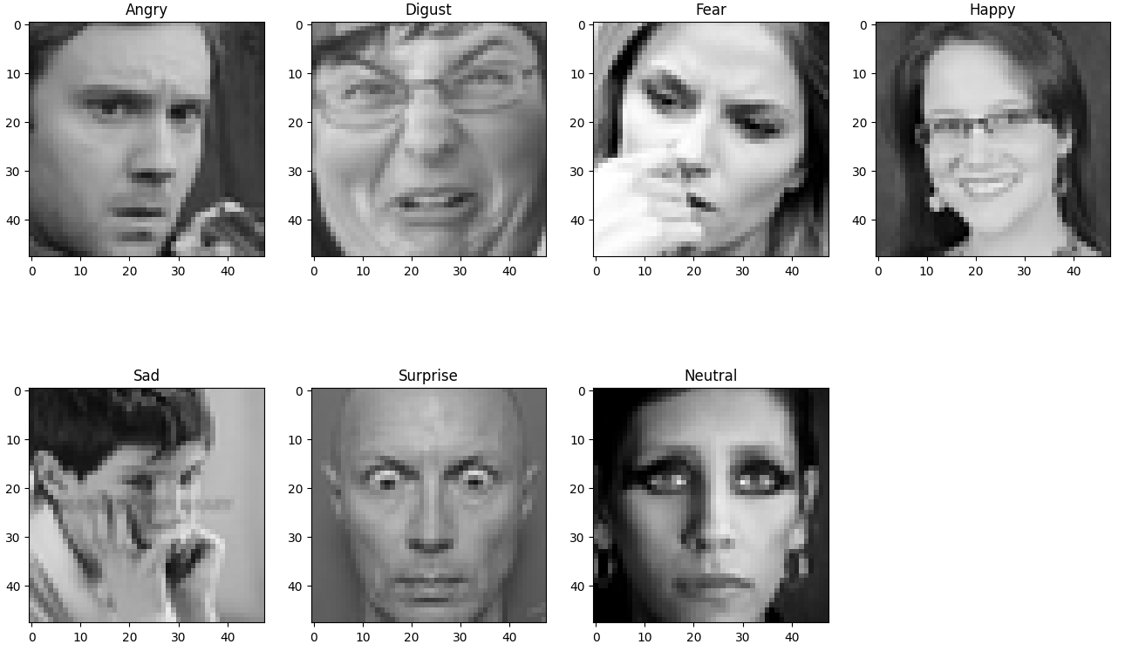
RESULTS
Demo Link
3/21/2024 Annual Review

